Slide 1

Secure Network Design
Cisco Online Internship

Slide 2

content
Campus Plan
Network Topology
Design Layout
Hierarchical Architecture
Devices Used
Security Features
Application Services
RFID Tag’s
Switch Security
Router Security
Vulnerabilities
Conclusion

Slide 3


Campus plan
The design is broken down into 5 major buildings:
Engineering block
Medical
Library
Hostel Block
Administration Block
There are necessary labs and administration offices for the network layout

Slide 4
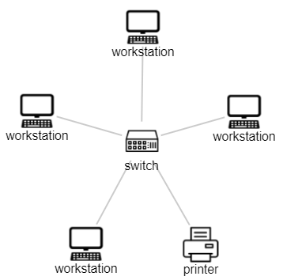

Network topology
Campus has different buildings with several departments in it
A star topology has been implemented in this design with a top-down approach
There is one main core router from which all connections are made.
This design can be expanded in the future if necessary

Slide 5
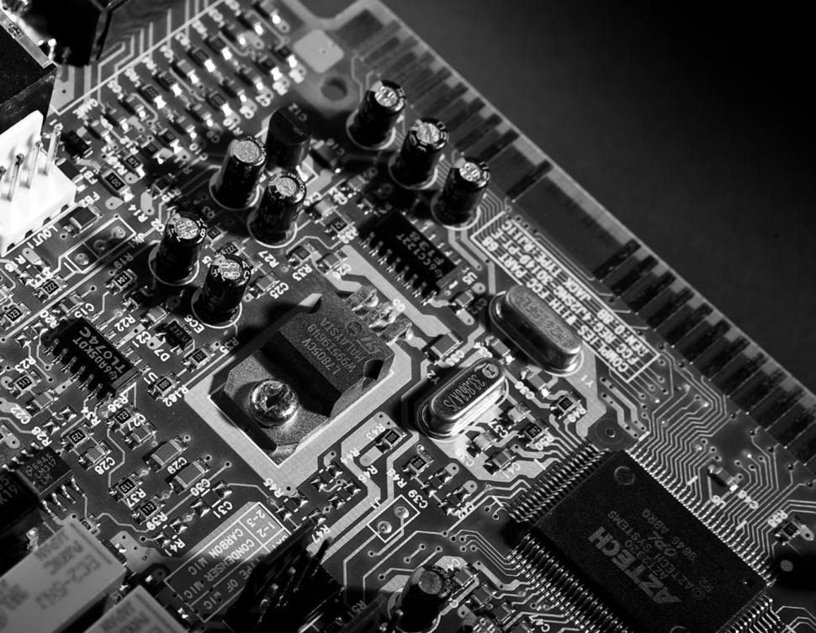
Design layout
Brief Description of the Network Design
Core Router sends/receives packets from other routers.
The core router divides into sub-routers for each department.
End devices like PC’s, laptops and mobile phones are all connected to a switch
There is an Email-server for each department.
Each department has Access-Point to connect to the campus Wi-Fi

Slide 6


Hierarchal Architecture
Core Layer
Connects to all departmental blocks.
Central Router
Intermediary between Access layer and Core layer
Routers and firewalls that connect to 4 main building and each department.
Distribution Layer
Provides access to end users
Access points, PC’s, printers, Cell phones.
Access Layer

Slide 7


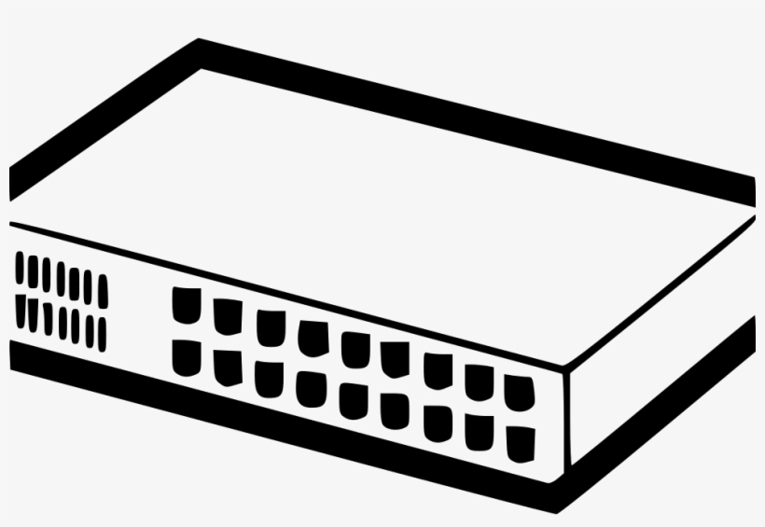

devices
Components used in the network design
Router
A router is a networking device that forwards data packets between computer networks
End Devices
Ex : PC’s , Laptops. Printers
Switch
A switch is a device in a computer network that connects other devices together.
Severs
In computing, a server is a piece of computer hardware or software that provides functionality for other programs or devices, called "clients".

Slide 8


Security features
Software firewalls
ACL’s
SSH Configuration
Switch Security
VPN-Tunneling with IPsec
RFID Authentication (Library)

Slide 9

Application services
Campus Website
Student Portal
Security Precautions
Campus Library Website
Search Database
Issue/Return Books
Email Services

Slide 10
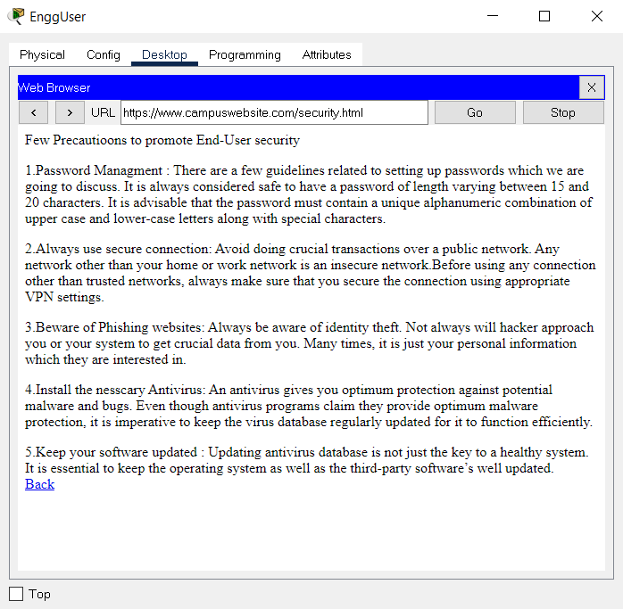
Application services
The End-Users should follow the precautions to avoid security related problems

Slide 11
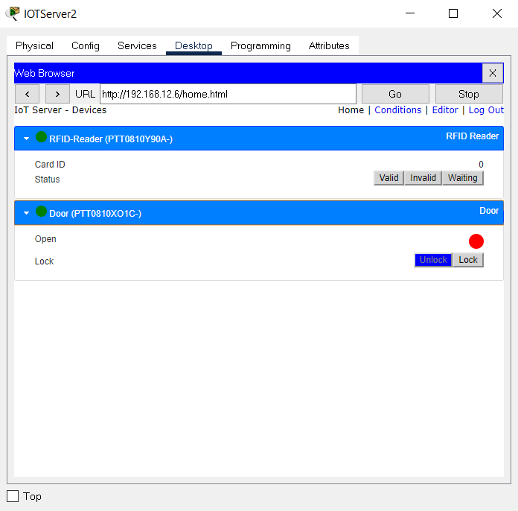
RFID TAGS
- Library Block
RFID
Radio frequency identification (RFID) uses radio waves to identify and track objects. RFID inventory systems use tags attached to all items that an organization wants to track. The tags contain an integrated circuit that connects to an antenna. RFID tags are small and require very little power, so they do not need a battery to store information to exchange with a reader. RFID can help automate asset tracking or wirelessly lock, unlock, or configure electronic devices

Slide 12
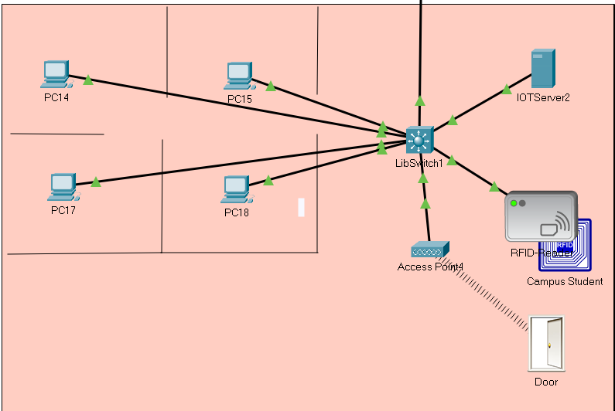
RFID Tags
CARD ID – 1001
He/ She is a student of the campus

Slide 13
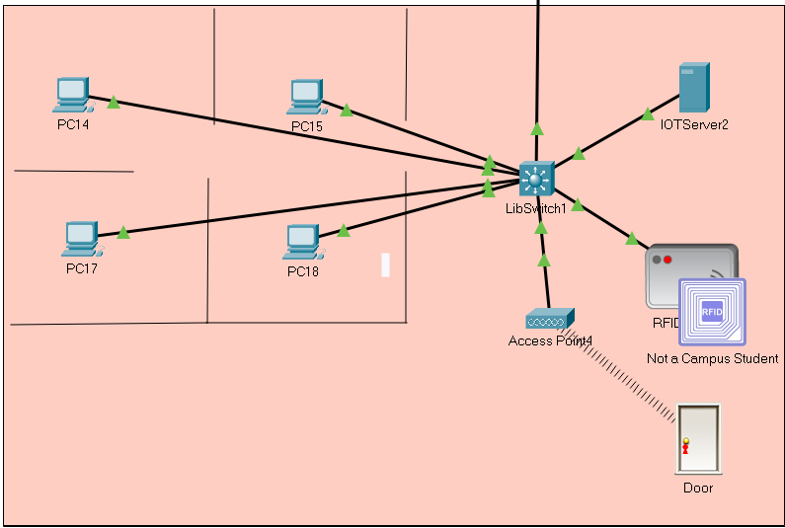
RFID Tags
CARD ID – 1002
He/ She is not a student of the campus

Slide 14

Switch security
Encrypted Password
Display Banner
Preventing Brute Force attacks

Slide 15



Switch security
Console Password
Password : switchpassword
VTY Password
Password : switchpassword

Slide 16

Attacks expected
DHCP Spoofing/ Starvation
DHCP spoofing occurs when an attacker attempts to respond to DHCP requests and trying to list themselves (spoofs) as the default gateway or DNS server, hence, initiating a man in the middle attack.
A DHCP starvation attack is a malicious digital attack that targets DHCP servers. During a DHCP attack, a hostile actor floods a DHCP server with bogus discover packets until the DHCP server exhausts its supply of IP addresses. Once that happens, the attacker can deny legitimate network users service, or even supply an alternate DHCP connection that leads to a Man-in-the-Middle (MITM) attack.
Prevention -DHCP Snooping
DHCP snooping acts like a firewall between untrusted hosts and DHCP servers. You use DHCP snooping to differentiate between untrusted interfaces connected to the end user and trusted interfaces connected to the DHCP server or another switch. When a switch receives a packet on an untrusted interface and the interface belongs to a VLAN that has DHCP snooping enabled, the switch compares the source MAC address and the DHCP client hardware address. If the addresses match, the switch forwards the packet. If the addresses do not match, the switch drops the packet.

Slide 17
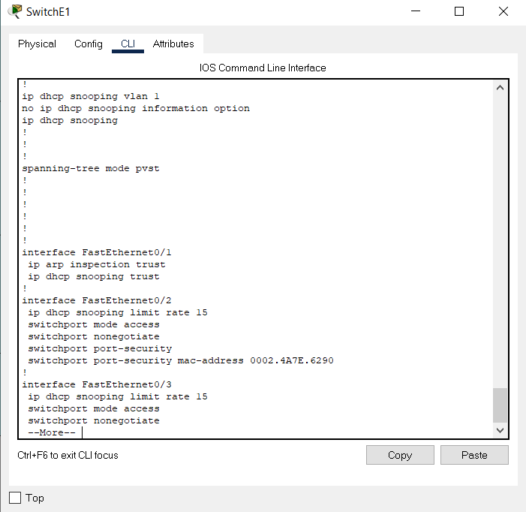

PREVENTION
DHCP Snooping
Enabling DHCP snooping on vlan1
Port connected to Router is the trusted port
Ports connected to the host is untrusted
Untrusted ports have a limiting rate of 15
Trusted

Slide 18
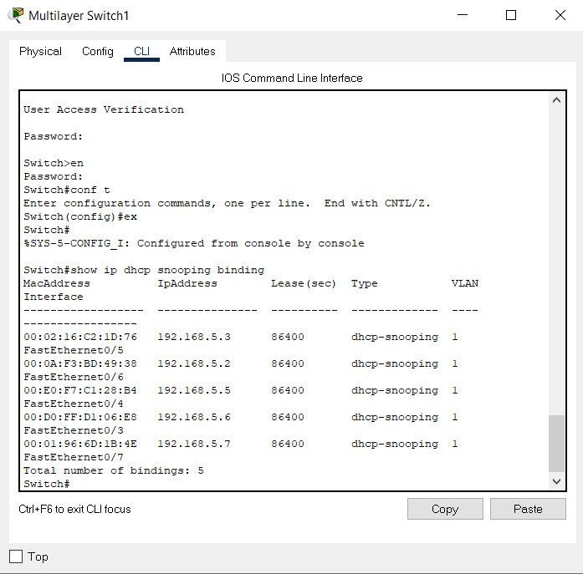
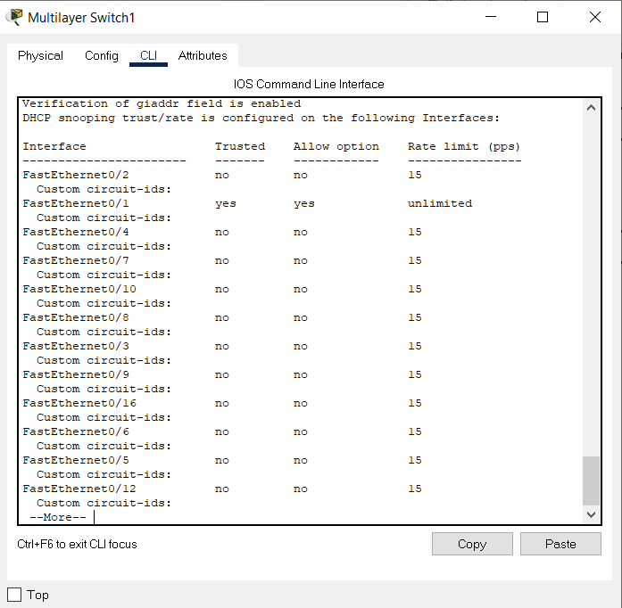
Dhcp snooping

Slide 19

ATTACKS EXPECTED
ARP Spoofing
In computer networking, ARP spoofing, ARP cache poisoning, or ARP poison routing, is a technique by which an attacker sends ARP messages onto a local area network. Generally, the aim is to associate the attacker's MAC address with the IP address of another host, such as the default gateway, causing any traffic meant for that IP address to be sent to the attacker instead.
ARP spoofing may allow an attacker to intercept data frames on a network, modify the traffic, or stop all traffic. Often the attack is used as an opening for other attacks, such as denial of service, man in the middle, or session hijacking attacks.
Prevention -Dynamic ARP Inspection
Dynamic ARP inspection is a security feature that validates ARP packets in a network. It intercepts, logs, and discards ARP packets with invalid IP-to-MAC address bindings. This capability protects the network from certain man-in-the-middle attacks.
Dynamic ARP inspection ensures that only valid ARP requests and responses are relayed. The switch performs these activities:
Intercepts all ARP requests and responses on untrusted ports
Drops invalid ARP packets

Slide 20
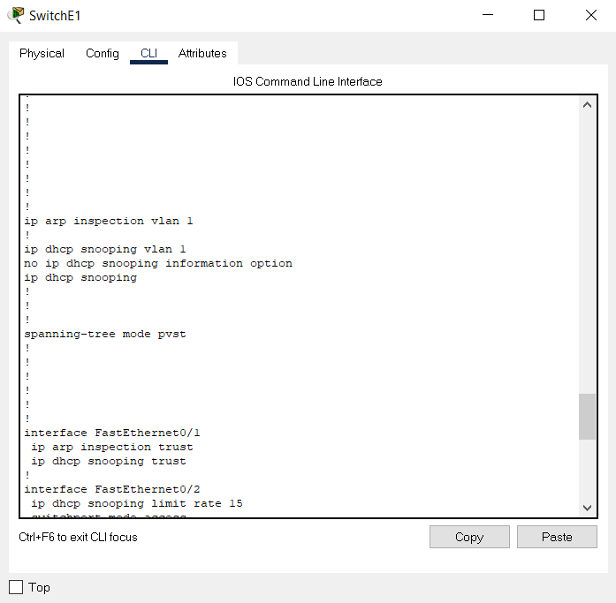
prevention
Dynamic ARP Inspection
ARP inspection set up at vlan1
Port connected to router is configured as trusted
Trusted

Slide 21
ATTACKS EXPECTED
CAM Table Overflow
Content Addressable Memory (CAM) tables are limited in size. If enough entries are entered into the CAM table before other entries are expired, the CAM table fills up to the point that no new entries can be accepted. Typically, a network intruder floods the switch with a large number of invalid source Media Access Control (MAC) addresses until the CAM table fills up. When that occurs, the switch floods all ports with incoming traffic because it cannot find the port number for a particular MAC address in the CAM table.
Prevention – SwitchPort Security
The CAM table overflow attack can be mitigated by configuring port security on the switch. This option provides for either the specification of the MAC addresses on a particular switch port or the specification of the number of MAC addresses that can be learned by a switch port. When an invalid MAC address is detected on the port, the switch can either block the offending MAC address or shut down the port. The specification of MAC addresses on switch ports is far too unmanageable a solution for a production environment. A limit of the number of MAC addresses on a switch port is manageable.

Slide 22

ATTACKS EXPECTED
MAC Address Spoofing
Media Access Control (MAC) spoofing attacks involve the use of a known MAC address of another host to attempt to make the target switch forward frames destined for the remote host to the network attacker. When a single frame is sent with the source Ethernet address of the other host, the network attacker overwrites the CAM table entry so that the switch forwards packets destined for the host to the network attacker. Until the host sends traffic, it does not receive any traffic. When the host sends out traffic, the CAM table entry is rewritten once more so that it moves back to the original port.
Prevention – SwitchPort Security
Use the port security feature to mitigate MAC spoofing attacks. Port security provides the capability to specify the MAC address of the system connected to a particular port. This also provides the ability to specify an action to take if a port security violation occurs.

Slide 23
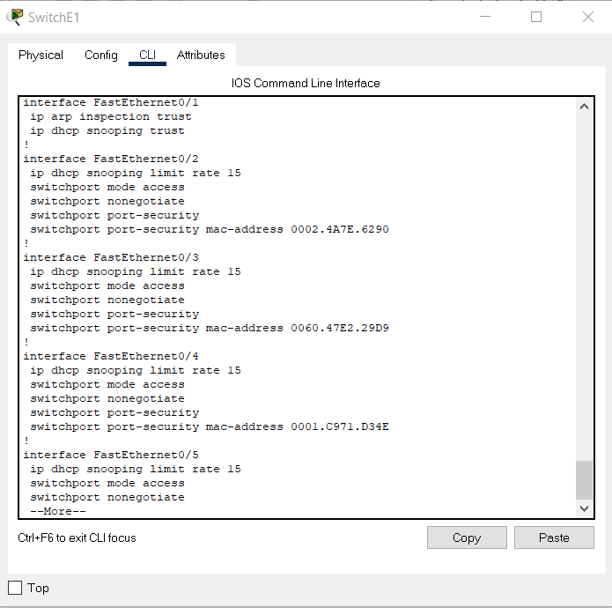
prevention
Switchport Security
Mac-Addresses configured statically for functioning ports
Prevents from Man-In-Middle attacks like MAC spoofing , DHCP Starvation attack etc.

Slide 24
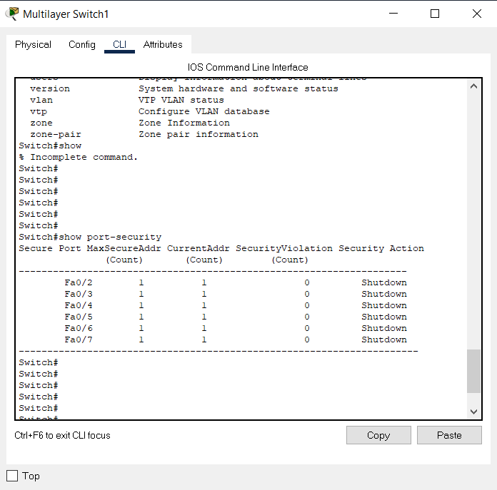
Port security

Slide 25
ATTACKS EXPECTED
BPDU Attack
Network Attackers can launch different types of attacks on Spanning Tree Protocol (STP). One type of Spanning Tree Protocol (STP) attack is to inject superior BPDUs in Layer 2 network. A superior BPDU is a BPDU which has a lower Bridge ID. In a normal network, superior BPDU's are generated by Root Bridge. If any other switch generate a superior BPDU, Spanning Tree Protocol (STP) recalculations will happen and the switch which generated superior BPDU will become the new Root Bridge
Prevention – BPDU Guard
BPDU Guard feature is used to protect the Layer 2 Spanning Tree Protocol (STP) Topology from BPDU related attacks. BPDU Guard feature must be enabled on a port that should never receive a BPDU from its connected device. If a switch port which is configured with Spanning Tree Protocol (STP) PortFast feature, it must be connected to an end device (For example: workstation, server, printer etc.). The PortFast is enabled only on access ports to speed the transition of access port to STP forwarding state. End devices are not supposed to generate BPDUs, because in a normal network environment, BPDU messages are exchanged by network switches.

Slide 26
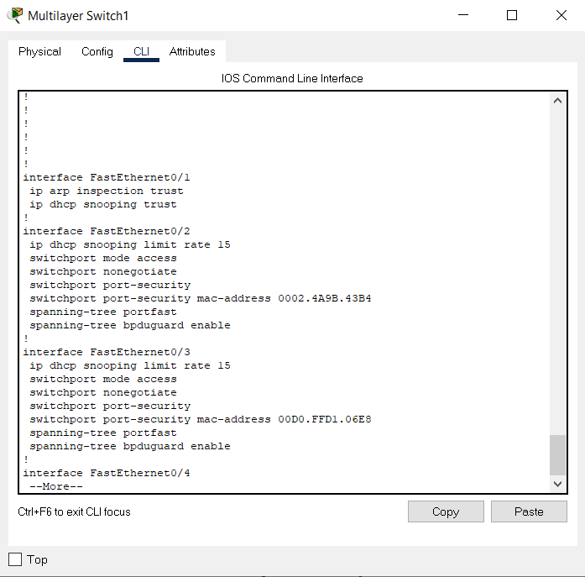

prevention
BPDU Guard
BPDU Guard enabled on all access ports

Slide 27

Securing the router
Encrypted Password
Display Banner
Preventing Brute Force attacks

Slide 28


router security
Console Password
Password : routerpassword
VTY Password – ssh
Password : routerpassword

Slide 29
ATTACKS EXPECTED
Sniffing Attack
Sniffing attack or a sniffer attack, in context of network security, corresponds to theft or interception of data by capturing the network traffic using a sniffer. When data is transmitted across networks, if the data packets are not encrypted, the data within the network packet can be read using a sniffer.
Prevention – Encrypting Traffic
Sniffing attacks are performed to collect information that is transmitted over the network. Hence you can prevent sniffing attacks by encrypting all the communication that is received or sent over your network. Encrypting communication will increase security and prevent sniffing attacks as cybercriminals will have to decrypt the packet to get the information they want. You can use secure VPN services to encrypt your communications.

Slide 30
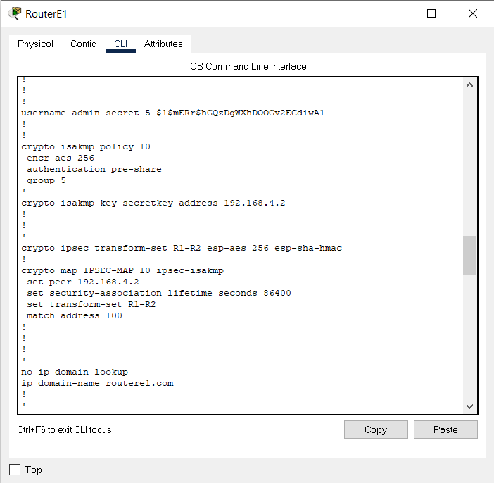

prevention
VPN Tunneling - IPsec
Encryption -> esp-aes 256 esp-sha-hmac
Protocol -> isakmp

Slide 31
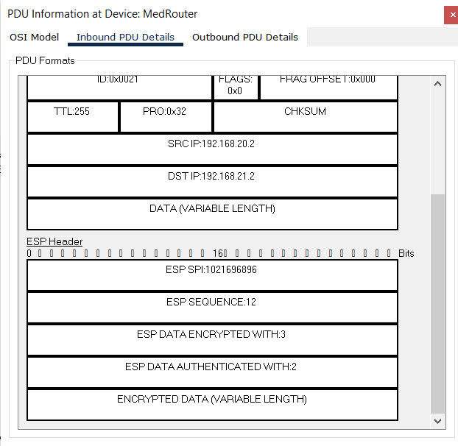
prevention
VPN Tunneling - IPsec
IPsec's method of protecting IP datagrams takes the following forms:
Data origin authentication
Connectionless data integrity authentication
Data content confidentiality
Anti-replay protection
Limited traffic flow confidentiality

Slide 32
vulnerabilities
Web Browser
Hypertext Transfer Protocol - HTTP
Hypertext Transfer Protocol (HTTP) is an application-layer protocol for transmitting hypermedia documents, such as HTML. It was designed for communication between web browsers and web servers, but it can also be used for other purposes
The major difference between the HTTP and HTTPS is the SSL certificate. The HTTPS protocol is an extended version of the HTTP protocol with an additional feature of security.
Solution - HTTPS
The full form of HTTPS is Hypertext Transfer Protocol Secure. The HTTP protocol does not provide the security of the data, while HTTP ensures the security of the data. Therefore, we can say that HTTPS is a secure version of the HTTP protocol.
Private key: This key is available on the web server, which is managed by the owner of a website.
It decrypts the information which is encrypted by the public key. Public key: This key is available to everyone. It converts the data into an encrypted form.

Slide 33
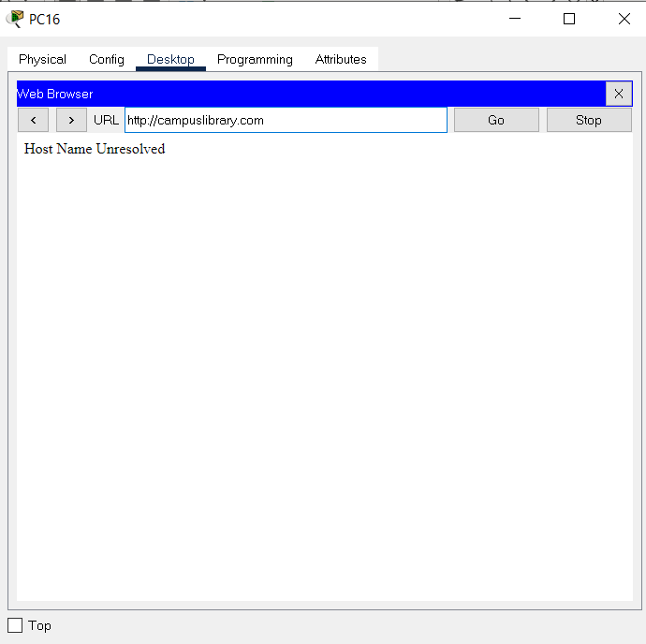
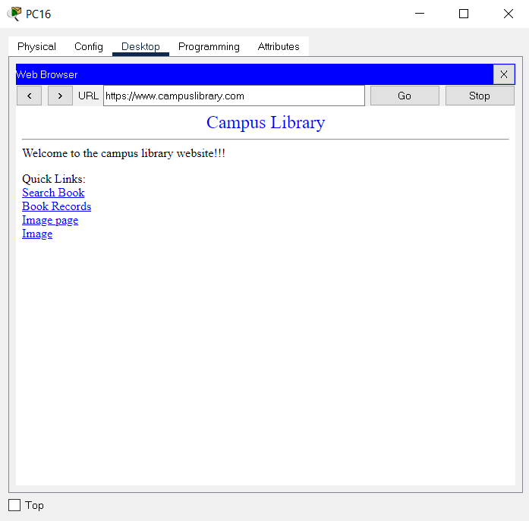
Vulnerabilities – web browser

Slide 34
vulnerabilities
Telnet
Telnet is the standard TCP/IP protocol for virtual terminal service. It enables you to establish a connection to a remote system in such a manner that it appears as a local system. The full form of TELNET is Terminal Network.
Telnet protocol is mostly used by network admin to access and manage network devices remotely. It helps them access the device by telnetting to the IP address or hostname of a remote device. It allows users to access any application on a remote computer. This helps them to establish a connection to a remote system.
Solution - ssh
SSH is a network protocol that is widely used to access and manage a device remotely. The full form of SSH is Secure Shell is a major protocol to access the network devices and servers over the internet.
It helps you to log into another computer over a network and allows you to execute commands in a remote machine. You can move files from one machine to another. SSH protocol encrypts traffic in both directions, which helps you to prevent trafficking, sniffing, and password theft

Slide 35
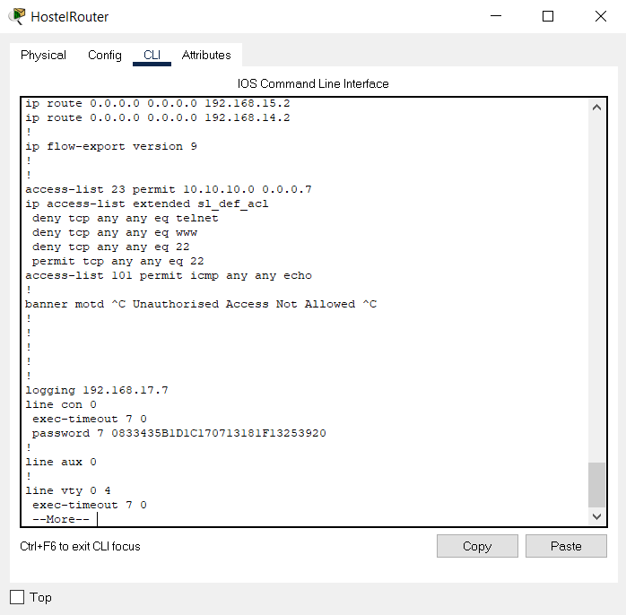
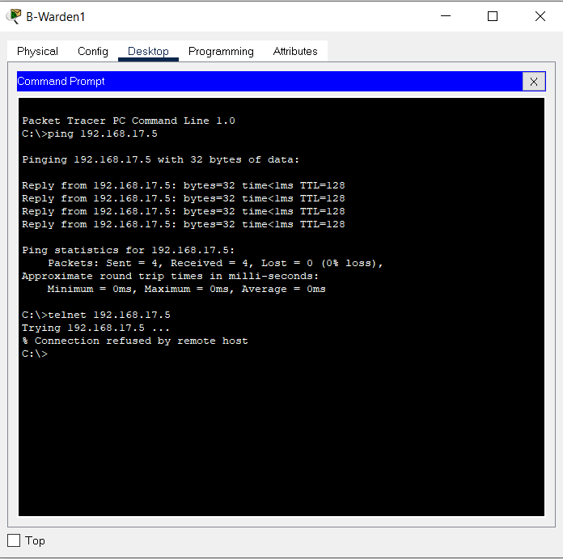
Vulnerabilities - telnet
Request denied

Slide 36
Network vulnerable to
DDos Attacks
A distributed denial-of-service (DDoS) attack occurs when multiple systems flood the bandwidth or resources of a targeted system, usually one or more web servers. A DDoS attack uses more than one unique IP address or machines, often from thousands of hosts infected with malware.
Malware / Virus
A virus is not self-executable; it requires the user’s interaction to infects a computer and spread on the network. An example is an email with a malicious link or malicious attachment. When a recipient opens the attachment or clicks the link, the malicious code gets activated and circumvents the systems security controls and makes they inoperable. In this case, the user inadvertently corrupts the device.
Malware attack is one of the most severe cyberattacks that is specifically designed to destroy or gain unauthorized access over a targeted computer system.

Slide 37
Network vulnerable to
Worm
A worm can enter a device without the help of the user. When a user runs a vulnerable network application, an attacker on the same internet connection can send malware to that application. The application may accept the malware from the internet and execute it, thereby creating a worm.
Botnet
It is a network of private computers which are a victim of malicious software. The attacker controls all the computers on the network without the owner’s knowledge. Each computer on the network is considered as zombies as they serve the purpose of spreading and infecting a large number of devices or as guided by the attacker.

Slide 38
Measures to be taken
Password Managements
Even though longer passwords are a bit difficult to remember, their complexity and length make the task of cracking these passwords a lot difficult. As it is known to all, hacking the password of any account gives the hacker complete control over the account. There are a few guidelines related to setting up passwords which we are going to discuss. It is always considered safe to have a password of length varying between 15 and 20 characters. It is advisable that the password must contain a unique alphanumeric combination of upper case and lower-case letters along with special characters.
Keep Software Updated
Updating antivirus database is not just the key to a healthy system. It is essential to keep the operating system as well as the third-party software’s well updated. The system and software updates not just contain performance optimizations but also a few security related updates which not just protect the software but also the user data related to the application as well as related antivirus patches.

Slide 39
Measures to be taken
Beware of Phishing Sites
Always be aware of identity theft. Not always will hacker approach you or your system to get crucial data from you. Many times, it is just your personal information which they are interested in. This information then comes in handy while creating alias accounts and identities which are then utilized for hacking. Apart from identity theft, yet another thing which is sought after and can be stolen without your notice is the IP address of your web devices. .
Always use secure Network
Avoid doing crucial transactions over a public network. Any network other than your home or work network is an insecure network. Even though the data over your device is encrypted, it is not necessary that the connected network transfers the data in an encrypted format. Moreover, there is a constant risk that the public network you connect with may be tapped thereby proving a risk to the data being exchanged over the network. Before using any connection other than trusted networks, always make sure that you secure the connection using appropriate VPN settings.

Slide 40
conclusion
Securing a Network
Network security is an important field that is getting more and more attention as the internet expands. The security threats and internet protocol should be analyzed to determine the necessary security technology. Securing the network is just as important as securing the computers and encrypting the message.
Points that must be considered when developing a secure network are
Confidentiality: Information in the network remains private
Authentication: Ensure the users of the network are who they say they are
Integrity: Ensure the message has not been modified in transit
Authorization (access): providing authorized users to communicate to and from .
An effective network security plan should be developed with the understanding of security issues, potential attackers, needed level of security, and factors that make a network vulnerable to attack. Tools to reduce the vulnerability of the computer to the network include encryption, authentication mechanisms, intrusion‐detection, security management and firewalls. In addition to protecting the network from outside threats, enforcing company network usage policies can prevent internal users from pulling in threats due to misuse.

Slide 41

Image SLide
Thank You .
Project By :
Sadhvi Selvaraj
RA1911043010007

